Slide 1
10 steps to creating an IEP

Slide 2

Step 1: Choose Student
    Click on picture of group of students under the Siras Systems log to get your student list
    Click on student name to go to IEP Manager
Note: Let the special ed. secretary staff know if any of your students do not appear or if you see any students on your list that are not yours.

Slide 3
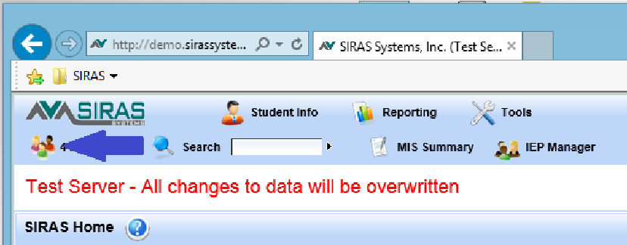
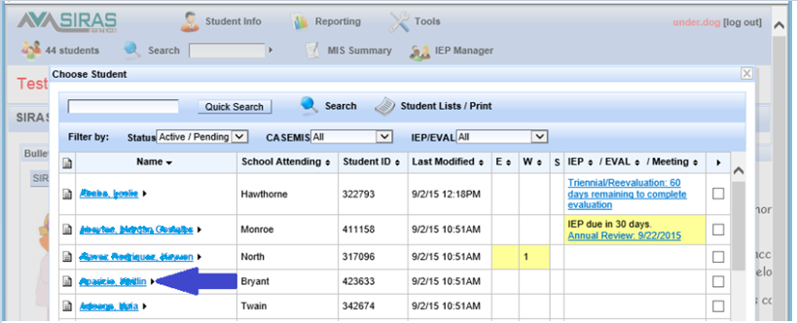

Slide 4
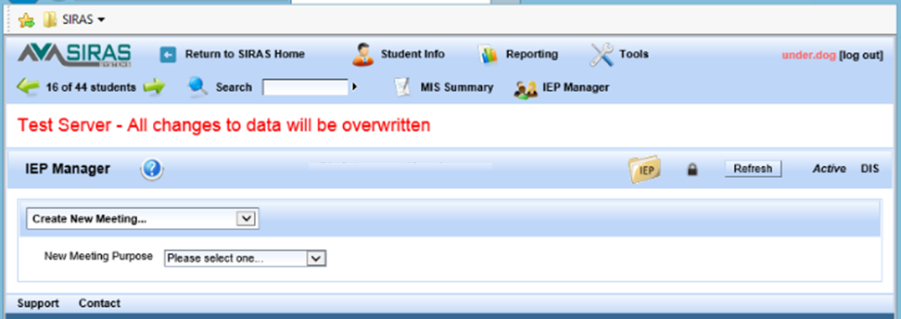

Slide 5
Step 2: Student Profile
Go to the Student Profile to check accuracy of information that will go directly onto IEP forms:
    Demographics: ethnicity, race, EL type
    Contacts: must at least have one primary contact
    Providers: must have case manager, all service providers should be listed

Slide 6
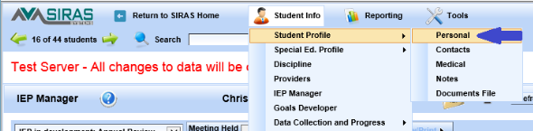
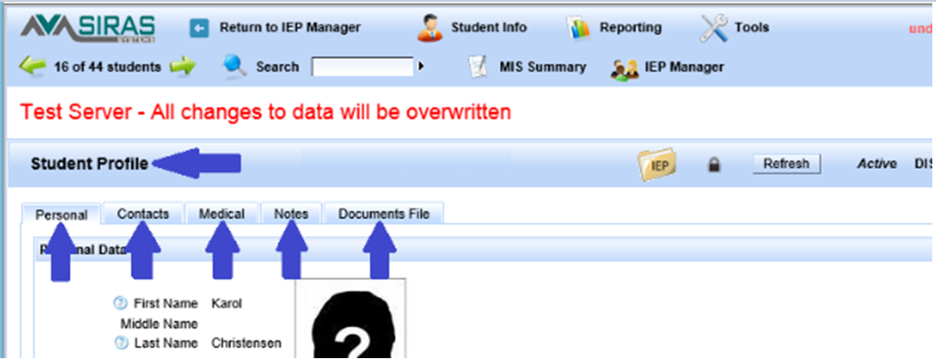

Slide 7
Step 3: Select a Meeting Purpose
    Select meeting purpose on IEP Manager to get all forms associated with that meeting type
    Refer to the handout ‘Selecting a Meeting Purpose’ for the definitions of each meeting type
    You may also view the definitions when you click on the meeting type itself from the drop down menu

Slide 8
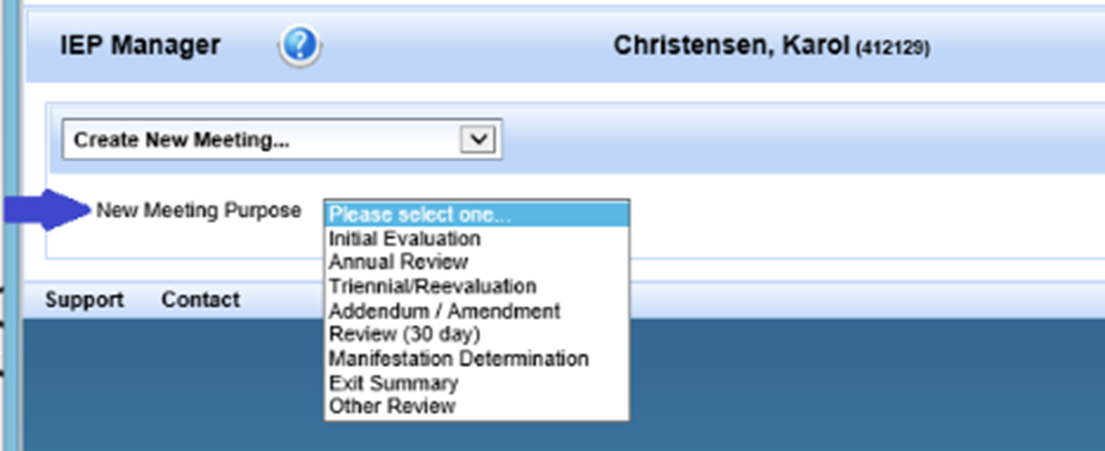
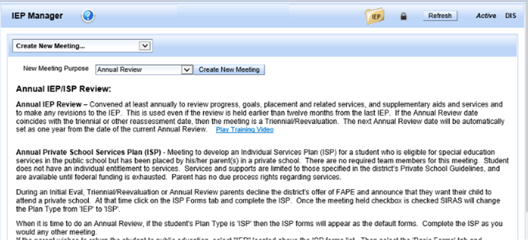

Slide 9
Step 4: Meeting Information
    Enter meeting date, time, and location, if known.
Note: You may enter this information at any time.

Slide 10
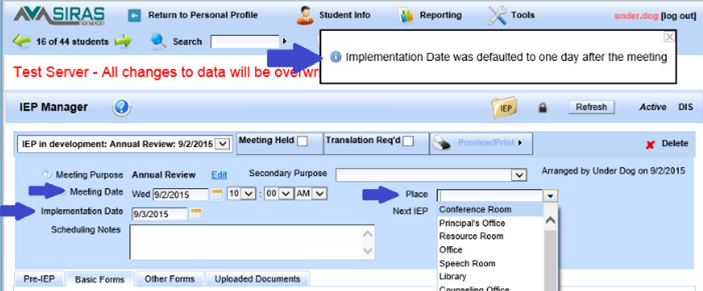

Slide 11
Step 5: Completing Forms
    Open form by clicking on form link
    Make changes to existing information as needed
    Add information as needed
    Save the form: You have a choice between "Save" which simply saves the information and keeps you on the same page and "Save as…” which saves the information and takes you to the location that you select from the menu. The menu defaults to the IEP Manager, but this feature allows you to bypass the IEP Manager and go directly to the next IEP form that you want to access. Cancel will not save the information you changed or added and will take you back to the IEP Manager.
Note: The Forms default to the Basic Forms tab. To create a Notice of Meeting please navigate to the Pre-IEP Forms by clicking on the Pre-IEP tab.

Slide 12
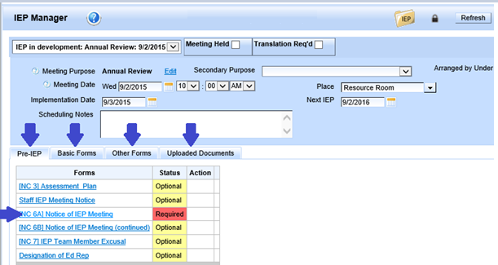
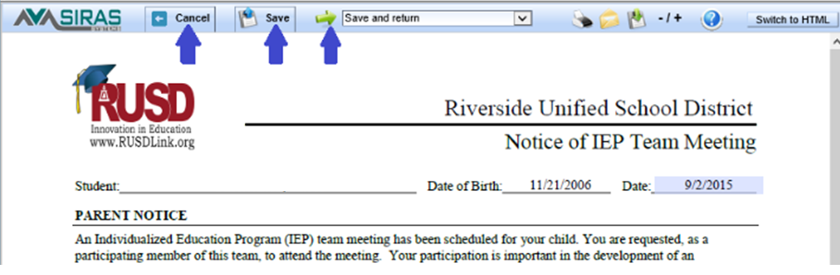

Slide 13
Step 6:
    All Required IEP forms must be addressed else the Meeting held checkbox or the Print/Preview button will remain inactive.
    use Optional forms as necessary
    A green check mark will appear on all forms you have completely filled out
    Orange form warnings will appear in the Status column to notify you of any information that needs to be completed.
    You may use these form warnings as an Agenda for the meeting being held with the parents

Slide 14
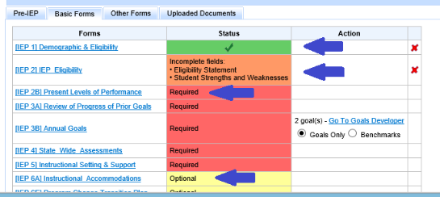

Slide 15

Step 7: Print/Preview
    Use the Print/Preview button on the IEP Manager to preview the paginated IEP for the meeting
    If there are errors, go back to the IEP Manager, and click on the page, make the correction, and save; then do Print/Preview again
    A Draft of the IEP should be developed prior to the meeting
    A ‘Draft’ watermark can be added to each page of the IEP by clicking the little arrow to the right of the Print/Preview button.

Slide 16
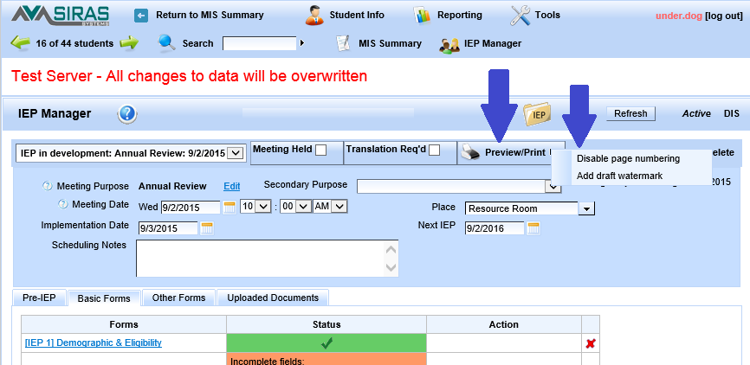

Slide 17
Step 7: Print/Preview Cont….
If you will be using a computer during the meeting:
    Bring drafts for team members to look at unless you will be projecting the IEP pages onto a screen
    You can make any corrections or changes directly onto the forms
    At the close of the meeting, use Print/Preview to print out a paginated copy for the team to sign
    This is the Official Copy of the IEP

Slide 18
Step 7: Print/Preview Cont….
If you will not have access to a computer during the IEP meeting:
    Print out the forms to present at the IEP
    Make copies of the forms for IEP team members to refer to during the meeting and mark Draft on those copies, but not on the Original Document
    Any changes or corrections made at the meeting will need to be made in handwriting on the Original Document
    Once signed, this becomes the Official Copy of the IEP. Destroy all Draft copies

Slide 19
Step 8: After the Meeting
    Click on Meeting Held, this will push all the CASEMIS data from the completed IEP over onto the MIS Summary page for reporting to the State.
    By default ‘Accepts Plan’ is entered as the Parent Response option.
    Handwritten changes made on the printed copy must be transferred over to the forms on the computer so the electronic copy and printed copy of the IEP are exactly the same
    Use the Print/Preview feature to view the final IEP for proofreading
    Proofread the IEP carefully to be sure all corrections were made
    You can still make changes on the forms and reprint that page if needed

Slide 20
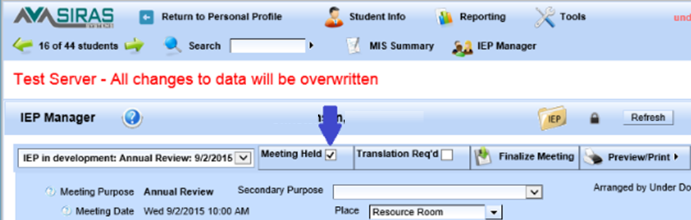

Slide 21
Step 9: Finalize the Meeting
    Check Translation Required if appropriate (only select if the parent requests that the IEP get translated). Best to select this need after the meeting.
    Translations can be completed any time, even after the IEP has been Finalized
    Fill in information on drop down menu regarding Parent Response & Participation
    Check any notes you have put in the Scheduling Notes box on the IEP Manager to be sure they reflect the comments you want to remain in the record after the meeting has been finalized

Slide 22
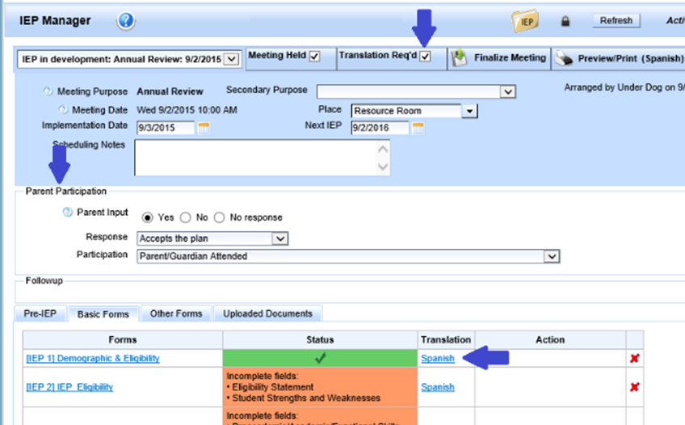

Slide 23
Step 9: Finalize the Meeting
    Click on Finalize to lock the IEP so no further changes can be made (It is recommended to Finalize a meeting no later than two weeks from the time it was held)
    Send signed Original paper copy to the office and click Sent to district office from the menu in the forms Status box under Follow up.

Slide 24
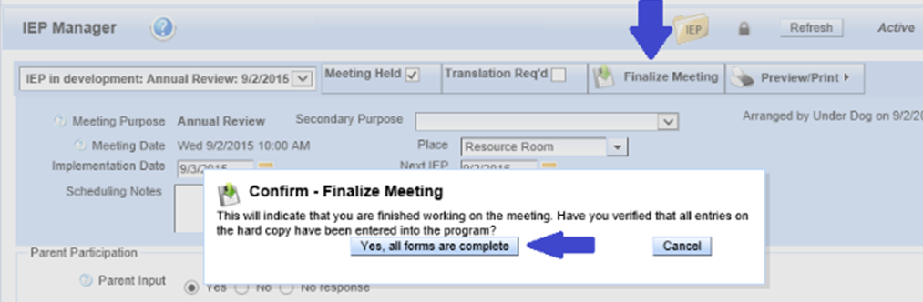

Slide 25
Step 10:
Depending on your district’s policy:
    Special Education admin staff will do a final review of the paper and electronic copies to ensure they are the same and validate the data
Note: Data will not transfer into the MIS Summary page after a meeting has been Finalized. If an IEP has been Reactivated and it required a change to a CASEMIS item, that CASEMIS item will need to be changed on the MIS Summary page separately.

Slide 26
Helpful Tips
    Blue question marks (?) located throughout the system will give you support in context
    Use the orange form warnings as an Agenda for the meeting with the parents
    Do not use the “back” button on your browser, as it may log you out from SIRAS
    Two people cannot work on the same IEP form at one time, but you can both be in the same student’s IEP

Slide 27
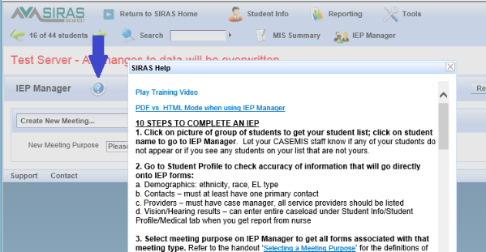

Slide 28
Note: Some names and identifying details have been
changed to protect the privacy of individuals.
Contact support@sirassystems.com for additional assistance

